Slide 1
Movies Rental application

Slide 2
Group 4
Od-Erdene Chuluunsukh
Luvsangombo Gochoodorj
Hossam Hassan

Slide 3
Agenda
Problem Statement
Implemented Use cases
Use case Diagram
Class Diagram
Sequence Diagram
Implemented Validation
STC conclusion

Slide 4

Problem statement

Slide 5
Problem statement
The Movie Rental System is designed to facilitate the management of movie rentals for members and administrators. Each member is assigned a unique ID and their personal information, including name, address, and phone number, is securely stored. The system catalogs movies with details such as title, format, genre, director, cast, quantity, and availability status.

Slide 6
Problem statement (continued)
Members can check out movies for a standard period of 7 days. Each checkout is recorded with relevant dates. Administrators manage member information, add new movies to the genre, and facilitate movie checkouts.

Slide 7
Problem statement (continued)
Each Administrator must have a unique ID and other information:
First Name
Last Name
Phone Number
Each Member must have a unique ID and other information:
First Name
Last Name
Address
Phone Number

Slide 8
Problem statement (continued)
Each Movie must have the following attributes:
Title
Format (e.g., DVD, Blu-ray)
Genre
Author (Author of the movie)
Director (Director of the movie)
List of Actors
Quantity Available
Price
Availability Status (indicating if the movie is rentable)
Each Actor, Director & Author must have the following attributes:
First Name
Last Name
Bio

Slide 9
Problem statement (continued)
Each Checkout Entry must have a unique Member ID and other information:
movie
Checkout date
Due date
Each Checkout Record must have the following attributes:
member
Total amount
List of Checkout Entries

Slide 10

Implemented Use-cases

Slide 11
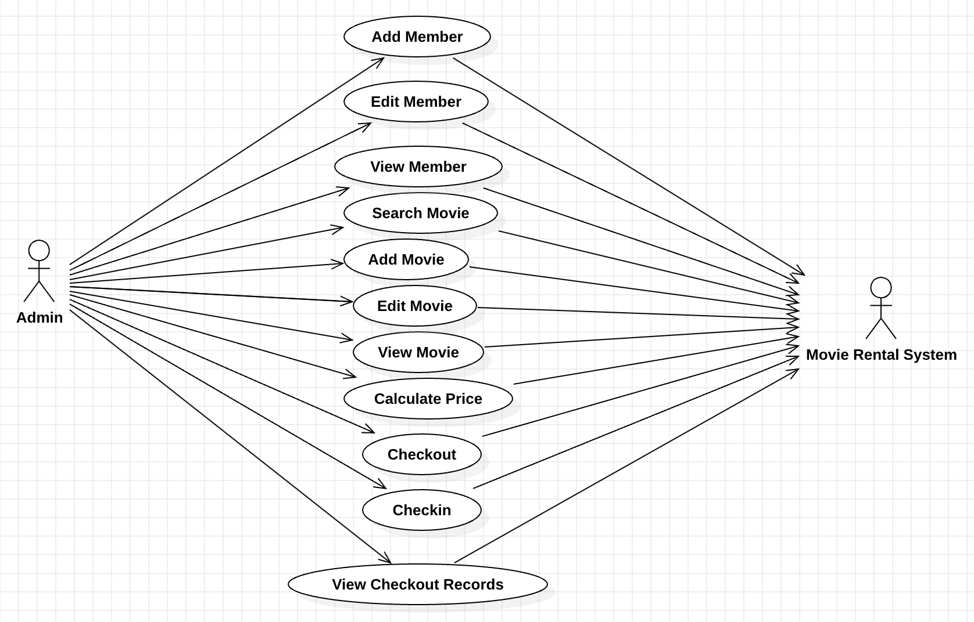
Use-Case diagram

Slide 12
Implemented Use-cases
Add Members, Movie.
Update Member, Movie
Remove Member, Movie
Search Movie by title.
Get Checkout, Checkin details.
List Members, Movies.

Slide 13
Members, Movies - ADD_USECASE
Use Action | System Response
1. Inputs member info | # 1. System validates all inputs
2. Click on save button | # 2. System save member info
3. Inputs movie info | # 3. System validates all inputs
4. Click on save button | # 4. System save movie info

Slide 14
Members, Movies - EDIT_USECASE
Use Action | System Response
1. Edits member info | # 1. System validates all inputs
2. Click on update button | # 2. System save updated member info to storage
3. Edits movie info | # 3. System validates all inputs
4. Click on update button | # 4. System save updated movie info to storage

Slide 15
Members, Movies - REMOVE_USECASE
Use Action | System Response
1. Select member to remove | # 1. System shows confirmation dialog remove certain member from storage
2. Select movie to remove | # 2. System shows confirmation dialog remove certain movie from storage

Slide 16
Movies - SEARCH_USECASE
Use Action | System Response
1. Input search text by title | # 1. System shows list

Slide 17
CHECKOUT, CHECKIN - USECASE
Use Action | System Response
1. Click on Checkout button | # 1. System add to checkout out history
2. Click on Checkin button | # 2. System change the checkout status

Slide 18
Members, Movies - LIST_USECASE
Use Action | System Response
1. To add, update, or remove a member | # 1. System shows members list
2. To add, update, or remove a movie | # 2. System shows movies list
3. To add a movie to the checkout list | # 3. The system displays the checkout history of member.

Slide 19
Class Diagram

Slide 20
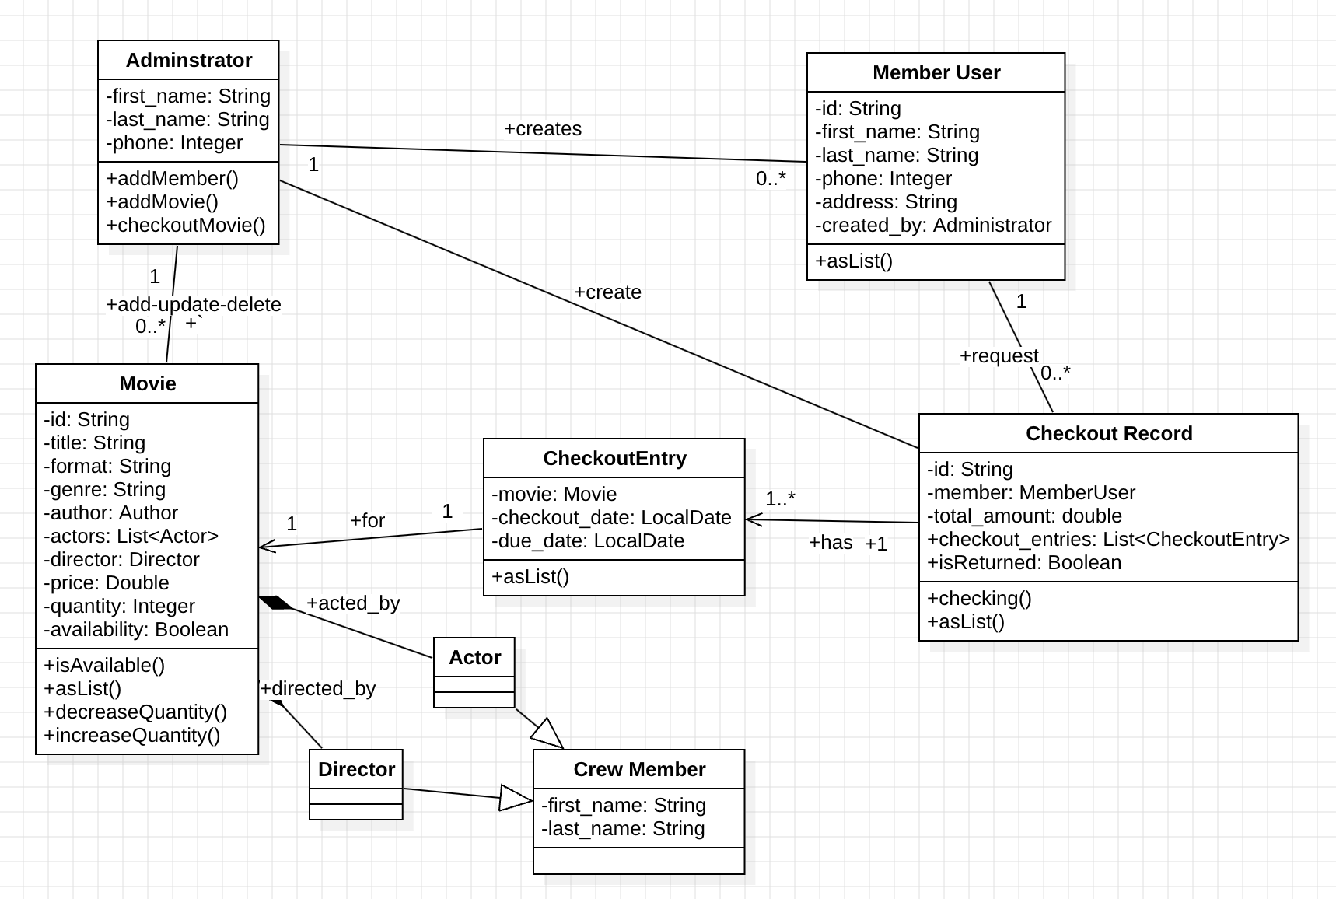
class diagram

Slide 21
Sequence diagrams

Slide 22
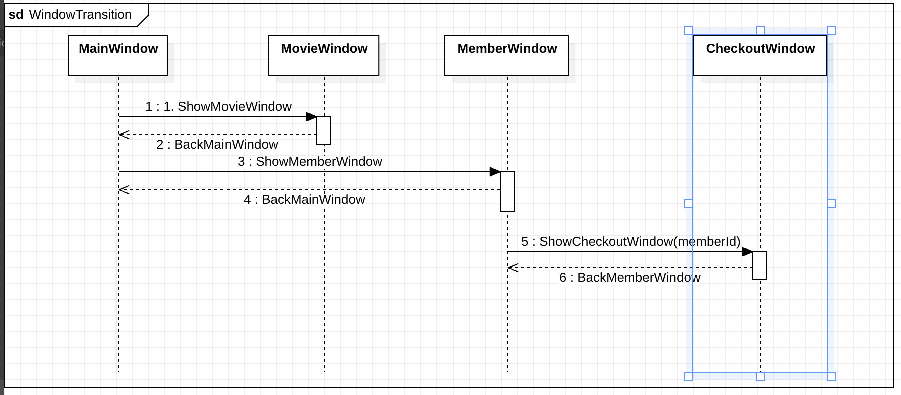
Sequence diagram 1

Slide 23
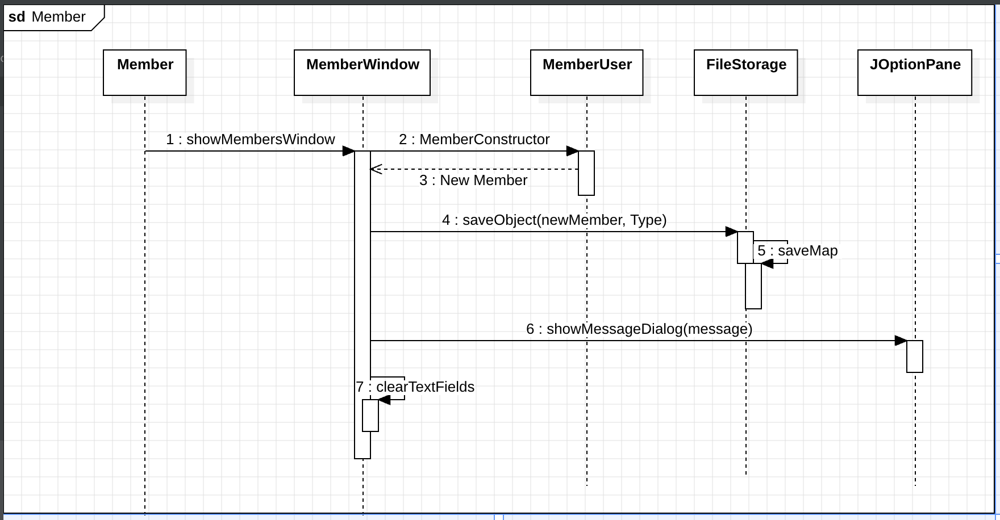
Sequence diagram 2

Slide 24
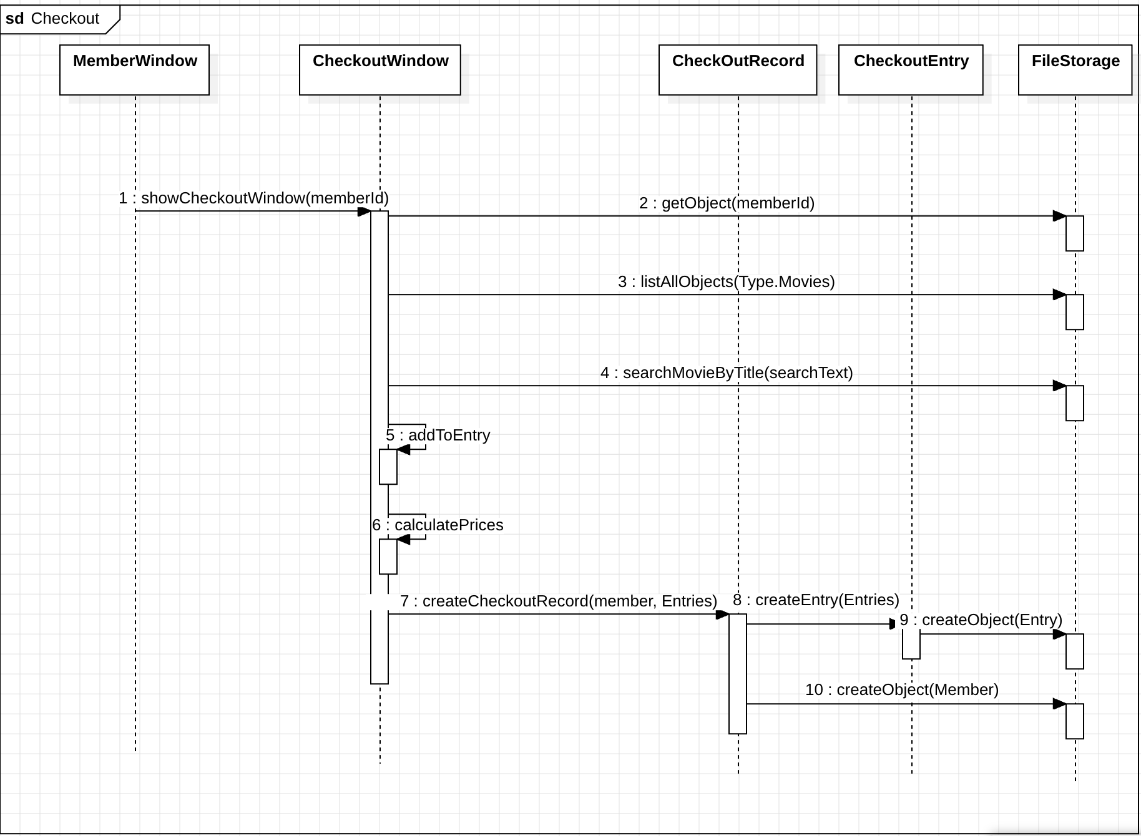
Sequence diagram 3

Slide 25
Implemented validations

Slide 26

Implemented validations
On adding new movie, member we validate that every field is not empty , else we will raise error for user.
Validate number fields
Validate phone number

Slide 27
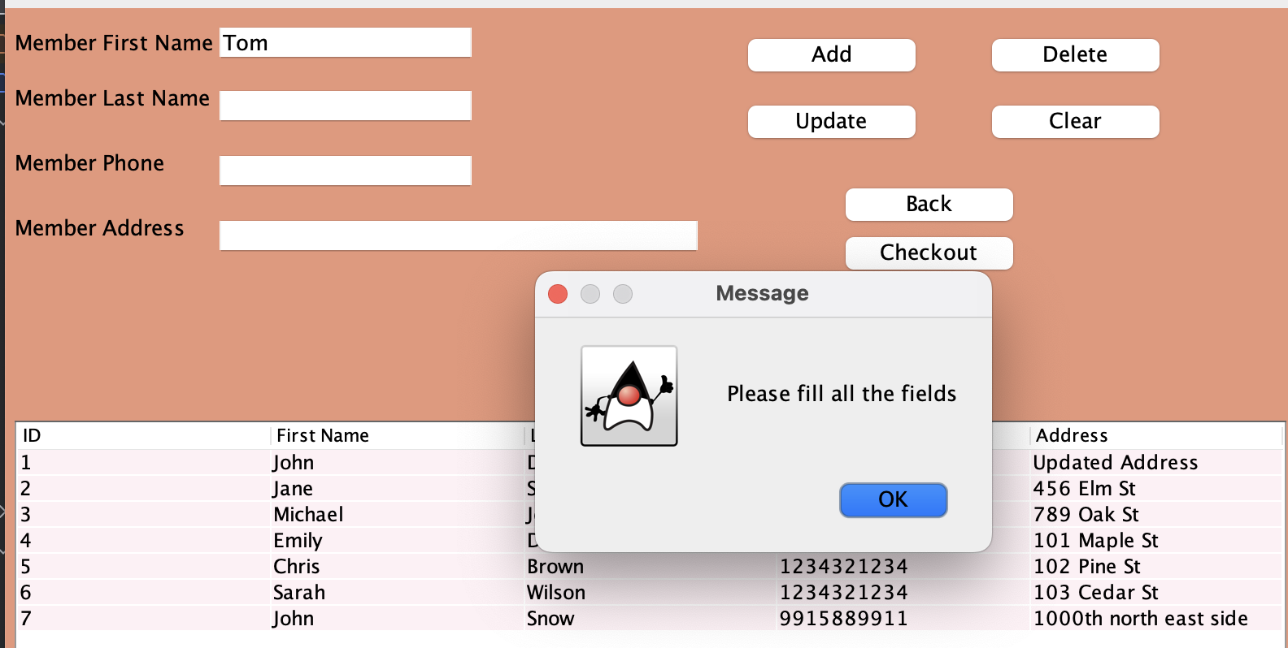
Validation Rule 1

Slide 28
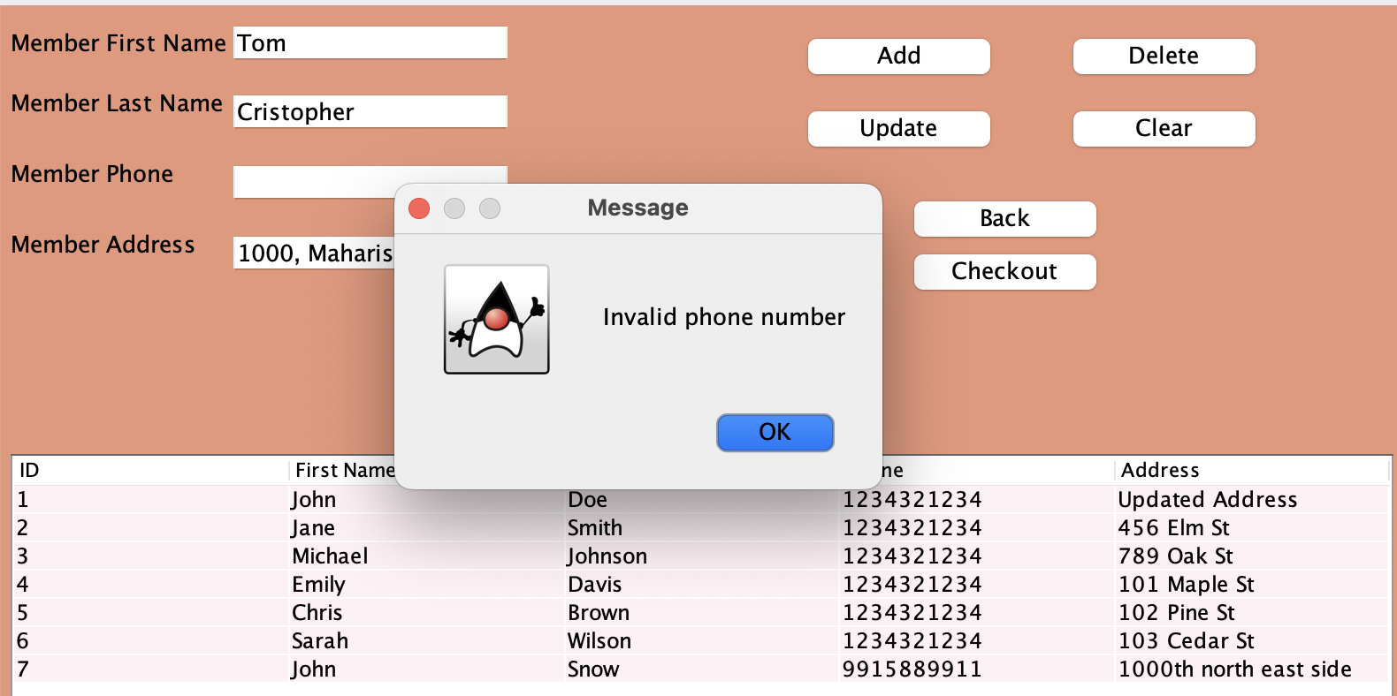
Validation Rule 2

Slide 29
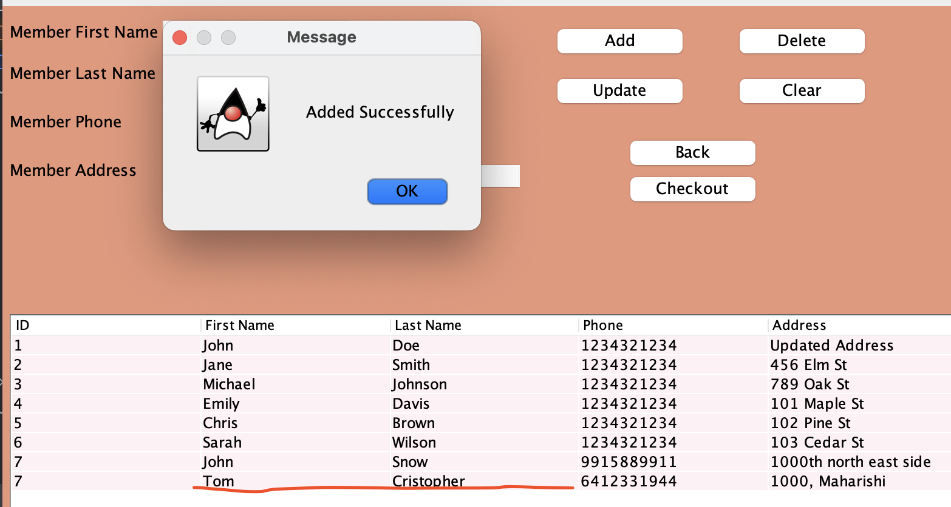
Validation Rule 3

Slide 30
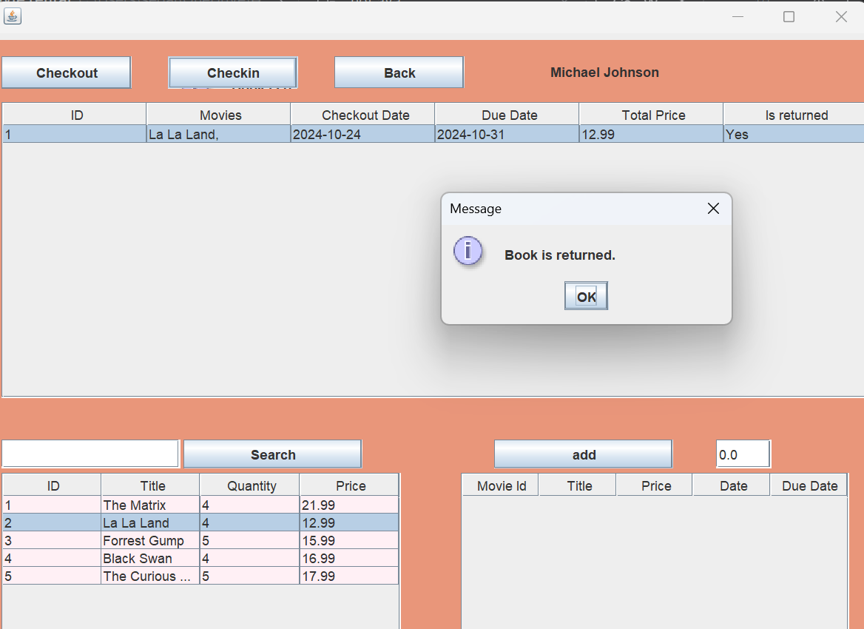
Validation Rule 4

Slide 31
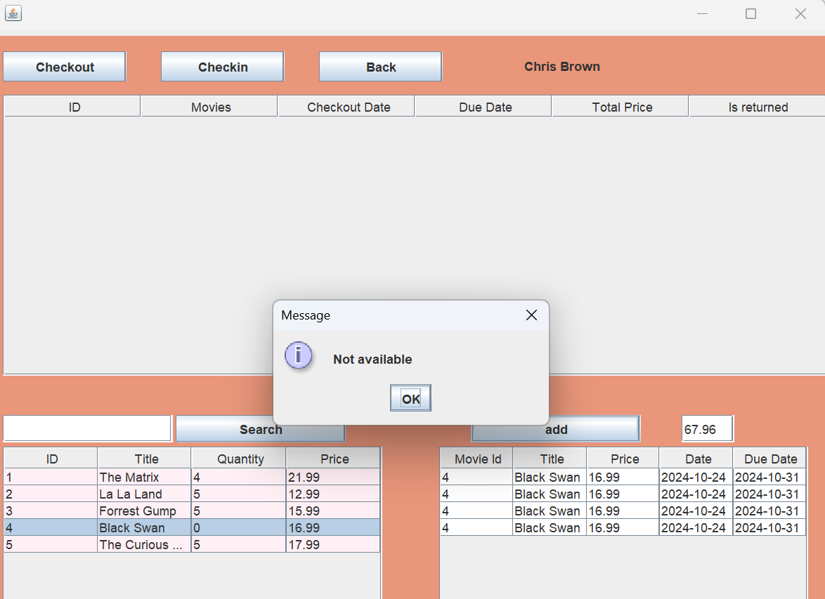
Validation Rule 5

Slide 32
Conclusion

Slide 33
STC Conclusion
To reach your desired goal, you must enter valid inputs, as invalid ones will prevent you from progressing to the next steps.
This movie renting system is consisting of many layers: User Interface layer, Business layer, and Data access layer.
Also this system streamlines the process of renting CD and DVDs by managing inventory and tracking rentals. It connects to the Science of Creative Intelligence by encouraging problem-solving, innovative thinking, and efficient design to enhance user experience and optimize operations.

Slide 34
THANK YOU

